Slide 1
Python Tutorial
By Alok kumar Nayak

Slide 2
Setting up Visual Studio Code
Install VS Code on Windows
First, navigate to the VS Code official website and download the VS code

Slide 3
Continued…
Second, launch the setup wizard and install VS Code.

Slide 4
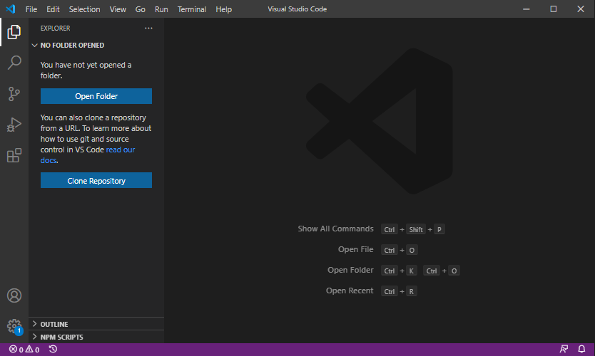
Continued..

Slide 5
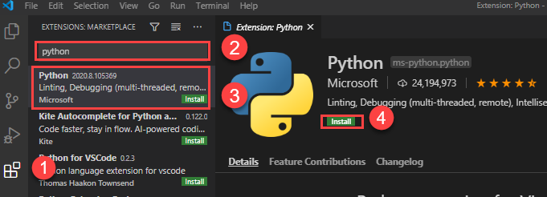
Install Python Extension

Slide 6
Our First Program in VS Code
print('Hello, World!')
print() is a built-in function that displays a message on the screen.

Slide 7
Running the Python program
python tut01.py
py tut01.py

Slide 8
Python IDE
Python IDLE is the Python Integration Development Environment (IDE)
This thing is called as REPL (Read Evolve Print under Loop) tool.
These tools are not standard editors for executing the Python programs. These are used to test small code only.

